Slide 1
Linux Administration
Week 9
DFIR and Backups

Slide 2
Disaster Planning and recovery
DLP (data loss prevention)
Tools and processes to prevent data from being lost
Can be monitoring, encryption, backups, endpoint activities and more
Compliance
Laws and regulations
GDPR
Have a plan in place that includes business continuity and business impact analysis. Should include prioritization
Internal recover, 3rd party support

Slide 3
Disaster Recovery
Journaling systems
Keeps track of changes not yet committed
System failure or power outage can be an issue with other systems, this will recover faster
Atomic transactions
More complex recovery
Windows vs Linux file deletion

Slide 4


What to do in the case of an incident
Verify incident happened (not just bug)
Classify incident type (DDOS, virus, rootkit, etc.) and priority level (critical? Important? Etc.
Preserve evidence
Recover
Post Mortem on incident

Slide 5
Post mortem on incident
High level summary of what happened
Root cause analysis
What did we do during the incident?
What was the time line of the incident?
What went well?
What didn't go well?
Focus should be on culture of learning and improvement, this is NOT a blame game

Slide 6

Activity – Post Mortem
Work in Pairs
Use a lab you've both finished
Using the provided template and questions, write a SHORT report on how your lab went
Sample Post Mortem report - https://web.archive.org/web/20220724194136/https://developers.googleblog.com/2013/05/google-api-infrastructure-outage_3.html

Slide 7
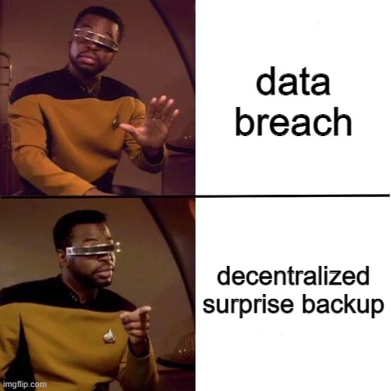
Backups
What is a backup?
Copy of our data/apps/settings/etc
Can be local or offsite
Can be on multiple types of hardware
Third party services that provide backups
Why we have backups?
Disasters (natural and unnatural)
Incidents
Accidents (user errors)

Slide 8
Backup types and guidelines
Incremental backups – only files since last backup (daily)
Full backups – copy of all files (weekly)
Forensic Copy (monthly)
Backing up more than just servers, config files, applications, changes, users and more
Backup Best practices from NIST https://web.archive.org/web/20220513214734/https://www.nccoe.nist.gov/sites/default/files/legacy-files/msp-protecting-data-extended.pdf
Security Guidelines for storage Infrastructure: https://web.archive.org/web/20220901001431/https://nvlpubs.nist.gov/nistpubs/SpecialPublications/NIST.SP.800-209.pdf

Slide 9
Check your backups!
Is your backup working?
How often do you check the backup happened and works?
Such as once a year on May 4th (Star wars days)
Where is it stored?
How is it stored?
Is it documented? Did we update the documentation?
Review backup policy and what's being backed up frequently (at least once a year)

